Slide 1
Academic Standards & Integrity
MGMT 515
Management That Transforms
© 2017 Steven Allen
All Rights Reserved
Notes:
This slide deck will provide you with an understanding of my expectations in Management 515, Management That Transforms, regarding Academic Standards and Academic Integrity.

Slide 2
Outline
Academic Standards
Bloom’s Taxonomy
Academic Integrity
Academic Integrity Policies
Violation Examples
Avoiding Violations
Resources
Notes:
These are the areas we will cover in this presentation. We will talk about Academic Standards, what they are, and why we adhere to them. We will also expand on these expectations using Bloom’s Taxonomy. We will continue with a discussion about Academic Integrity, what it is, and different acts which violate Academic Integrity. Next, we will examine both the University’s and my policies regarding any violations of Academic Integrity. I will also provide you some examples from even famous people who have committed plagiarism. After all of that, we will talk through key ways to avoid violating these policies and I will provide you some resources to use when it comes to citations for your written work.

Slide 3
Academic Standards
An appropriate level of Rigor for graduate studies
Tied to UONA’s Institutional Objectives
Instill applied learning by joining theory and practice
Enable student’s to meet career goals
Notes:
So, with that out of the way, let’s get to the substance of this topic. As an institution of higher learning, the University of North America prides itself and is accredited, in part, based on its academic standards. It means the a level of work where students are challenged to think, perform, a grow to a level they were not at previously. Essentially, the essence of education!
These expectations align with the University’s Institutional Objectives. This work will develop them by joining theory and practical examples in their assessments.
By applying yourself in this environment, we will help you meet your career goals by growing to a level where you can be transformative leaders in your profession.

Slide 4
Academic Standards (cont)
Attendance and participation
No excused absences
Completing assignments is attendance
Level of Effort in Assignments
READ!!!
Think!!!
What is the point of learning here?
How would I apply this in a real work environment?
Do NOT Google for answers!!!
Wikipedia, Studyguide.com, Chron.com, and websites like these are not acceptable sources
Notes:
Now, as the University’s administration and faculty are expected to provide instruction which will meet these academic standards, the students have responsibilities as well. First and foremost is attendance. In 1977, the famous screenwriter and director Woody Allen said “80 percent of success is showing up.” Much can be said of graduate school as well. You must attend ALL classes; there are no excused absences. In the on-line world, this is done by you completing assignments on time. Just logging into Moodle is not enough to say you attended class. If you miss more than two classes (which means you fail to turn in two assignments or they are extremely late), you will receive an F in the course.
Once you have shown up, then what? By providing an appropriate level of effort, you will learn and grow in this course to prepare you for future roles in your organizations. First and foremost is to read. I appreciate you are trying to balance work, family, and school at the same time. But if you do not read the assignments (or watch the assigned videos), how can you hope to actually learn?
Once you have the building blocks of knowledge by doing your reading, it is time to think. This is graduate school; a place to go above and beyond just repeating what you have read or watched. Look at the questions on your assessments and in the discussion boards and ask yourself what am I trying to demonstrate I have learned? Really look at the theories and determine how you would apply them in your work environment.
This next on is very important. Do NOT Google for answers. I have had many students who are so desperate to just complete the assignments that they just Google the question, cut and paste the answer from a web site, and move on. How does this demonstrate you have actually learned anything? Now, yes, in the future we will always have Google to get an answer of facts and theories, but it cannot replace thinking on how to apply those theories to a given situation. Only you can do that as a graduate of a Masters program with the knowledge you have acquired.
In a related note, if you are using sources you found on the web, Wikipedia, studyguide.com, chron.com, and the websites like these are not acceptable academic sources. Peer reviewed journal articles and other published texts are what you should use if you are going outside the course material.

Slide 5
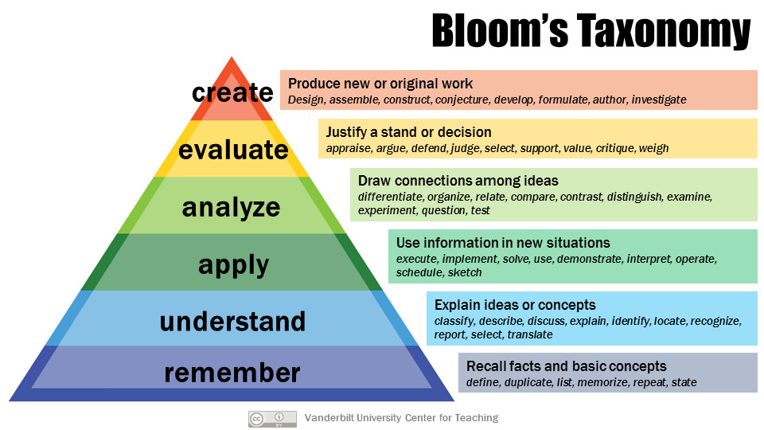
Bloom’s Taxonomy
Notes:
To further explain the type of work you will be doing in this course, I will use Bloom’s Taxonomy. This is a construct which explains the increasing levels of cognitive, or thought, effort and complexity. At the base is Remember, or just being able to recall information and recite it. Next up is to Understand. This is where you can recognize of discuss in your own words a concept or idea. As we move up the taxonomy, we get to Apply. This is where you can take the information you understand and use it in new or novel situations. Next is to Analyze. Here, you can connect different ideas you have been exposed to others and do things like compare or contrast viewpoints. Next is to Evaluate. Here you can justify a position or judge another’s decision using facts or data; not by just stating opinion. And finally, we get to the highest cognitive level, which is Create. Here, you are producing new work and developing ideas not seen before.
In Management that Transforms, I am looking for you to work at the understand through evaluate levels. This reinforces why it is necessary to do the readings and process the new information as we stated earlier.

Slide 6
Academic Integrity
Practices that support scholarly inquiry and ensure student’s can work in an honest environment. This means it is free of:
Plagiarism
Cheating
Copying/Sharing work
Notes:
The foundation of Academic Standards lies in Academic Integrity. This is where we operate in a way which ensures honesty, fairness, and a genuine search for knowledge. This means there is no plagiarism, which is using someone else’s work without giving proper credit. This, unfortunately, occurs frequently in my classes here. I am hoping this semester will be the first where I do not have this problem. We will talk much more about this issue in the following slides.
Another way students violate academic integrity is through cheating. This can be copying off someone’s test, or even creating false data or information to support a point.
Another violation is copying or sharing work. This is where two or more students are willingly involved. Where I have seen this is when two or more quizzes end up with the same answers, including spelling mistakes and grammar. None of these practices are allowed and will result in the penalties laid out in the Academic Integrity Policy that follows.

Slide 7
Academic Integrity Policies
University Policies (pp. 29-30 in the UONA Catalog)
1st Instance handled at Professor Level
Any instance will be placed in student’s file
If student fails course due to violations, issue is forwarded to the Academic Review Committee
My Policies
A Zero for the assignment where violation occurs
On first Instance, one chance to redo the assignment without violations
An F in the course for repeated violations and referral to the University
Notes:
You can see the University’s policies regarding Academic Integrity violations on pages 29 and 30 of the UONA catalog. What you see here is a synopsis. If I encounter a violation, the first instance is to be handled at my level. I am expected to report the act to the University and they will place a letter in your file for reference. If you repeatedly commit violations or if you end up failing due to these violations, I will refer your case to the University’s Academic Review Panel. You may appeal your case then.
Now, as for my policies (and they are written at the top of each quiz)…The first instance will result in you receiving a Zero for the entire assignment. If the event is not too egregious, I may give you an opportunity to redo the assignment and earn your grade.
If you have multiple violations, I will refer your case to the University before assigning a failing grade for the course.

Slide 8
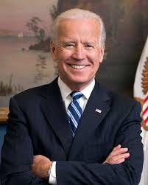
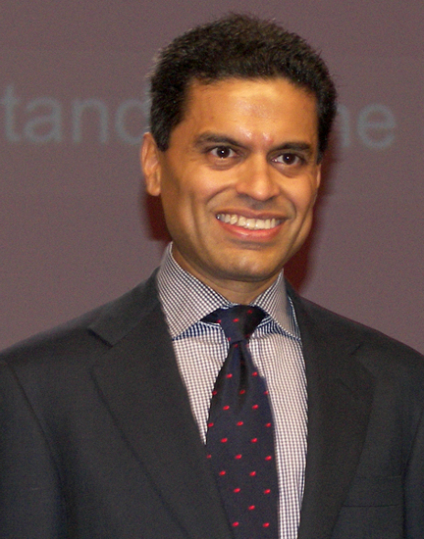
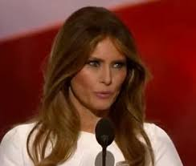
Violation Examples
Dropped out of his 1988 presidential bid when found to have plagiarized from a British lawmaker’s speech
Suspended from CNN and Time magazine for plagiarism issues.
Copied much of her speech at the Republican National Convention from First Lady Michelle Obama’s speech.
http://time.com/money/4413480/melania-trump-plagiarism-high-profile/
Notes:
You may think plagiarism is a rare occurrence or only happens to dishonest people. Here are three cases with famous people who committed plagiarism in their speeches or written work.

Slide 9
Avoiding Violations
Proper citations
APA format (see other presentation)
Even if it is course content, still cite!
Do NOT cut and paste from websites or e-books
If you copy and paste into and out of translation software to change words, it is still plagiarism.
Notes:
The key is to just avoid violating the rules all together. Believe it or not, it is really easy to do. The trick is just to properly cite your sources. Use quotes or paraphrase and give credit by citing your sources in the American Psychological Association’s format. There is another slide presentation in Moodle which reviews this. Now, even if you use course content like this presentation, you need to cite it.
Also, do not cut and paste from other websites or e-books. I have had several students who move text from someone else’s work into a translation program like Google Translate. They then translate it back to English. While it makes it more difficult to discover plagiarism, it is still plagiarism.
Really, just think back to the Academic Standards slides earlier. You are here to learn; don’t just use someone else’s words to fill in a blank. I want you to stretch and grow to be able to have success in the future.

Slide 10
Citation Resources
Microsoft Word has a citation generator
https://www.youtube.com/watch?v=CnVq_BpwP2E
Websites like Citation Machine
http://www.citationmachine.net/apa/cite-a-book
Review the APA format slides in Week 1 on Moodle
Notes:
There are a few references when it comes to citing sources I wanted to share. First, in Microsoft Word there is a tool where you can type in the information and the program will create a citation for you in APA format. The link is to a YouTube video explaining how to create citations.
There are also web-based tools to do the same thing. Citation Machine is just one of them and I have provided a link here.
Finally, as I mentioned last slide, there is a slide presentation on APA format in Week 1 of MGMT515 in Moodle.

